Slide 1
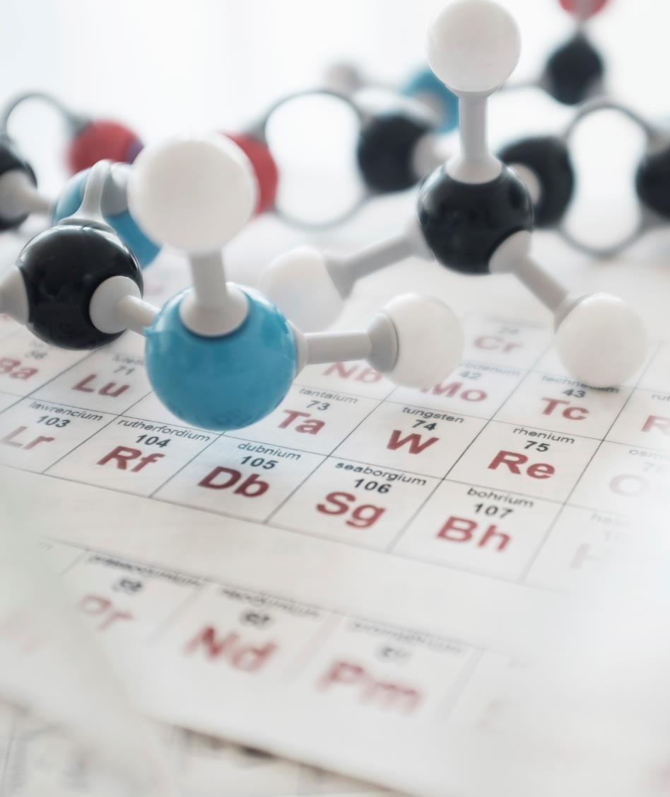
Phosphorus:
Subject: Biochemistry.
Dept.: Transfusion Medicine, Heamtology.
Submitted By: Uswa Tahir.
Submitted To: Prof. Shabbir Hussain.

Slide 2
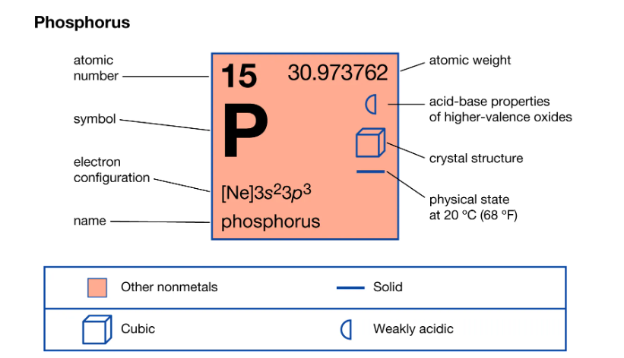

Slide 3
Which form of Phosphorus is used in our body metabolism?
Phosphate means total anionic phosphorus that occurs in H2PO4-/HPO42- or NaHPO4. Concentrations of Phosphorus in plasma or serum are generally expressed as elemental phosphorus or inorganic phosphorus (Pi).

Slide 4
Distributions:
The adult human body has about 700gms of phosphorus about 85% in skeleton.
Whole blood contains 48mg/dl phosphorus which chiefly present as inorganic phosphorus (pi), organic phosphate esters and lipid phosphorus.
RBCs contain more of organic phosphate while plasma has inorganic phosphate.
In adults, the plasma inorganic level is 3 to 4.5 mg/dl.
In children, the level is higher to 4 to 7 mg/dl. ( this is due to growth hormone).
The ratio of anions H2PO4- and HPO42- is normally is 1: 4.
Serum Pi levels go through variations due to intake of food and cardiac rhythm.

Slide 5
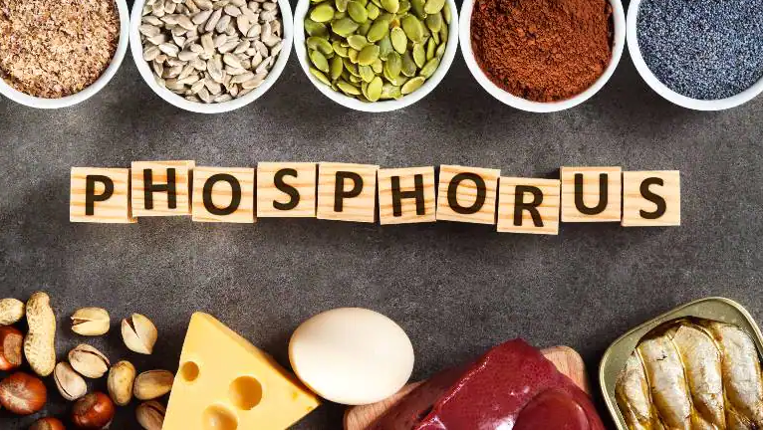
Dietary Sources:
Food that is enriched with calcium is also rich in phosphorus.
This includes milk, beans, cereals, egg yolks and meat.
A large part of vegtable phosphorus exists as phytates of Ca and Mg.

Slide 6
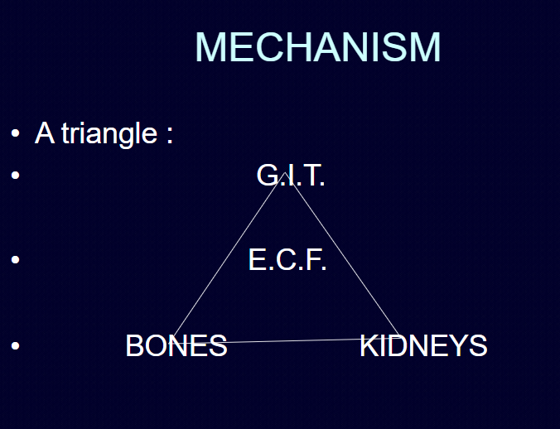
Growth
Shows
Sales

Slide 7
Absorption:
The phosphorus ingested with food is absorbed in inorganic phosphate form; 500 to1000 mg is absorbed per day; about 65% of indigested phosphate in absorbed in the absence of vit.D; absorption rate can be increased upto 90% by Vit.D.
Absorption is brought about by Na+/PO42- co-transporter.
Low plasma Pi level stimulates the formation of active Vit.D by renal proximal convoluted tubules.
An optimum Ca:P ratio is helpful in absorption of both these minerals.
Excess of aluminum and intake of antacids decrease its absorption.
Excessive intake of iron salts also interferes with phosphorus absorption because of formation of Ferric Phosphate.

Slide 8
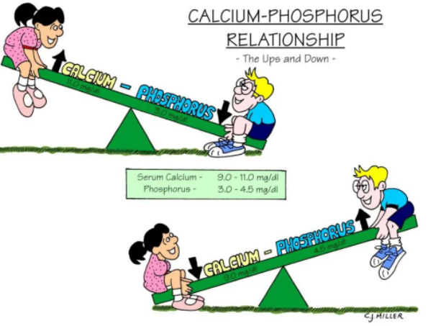

Slide 9
Excretion And Reabsorption:
In, general all the phosphorus loss from the body occurs through urinary excretion.
The phosphorus present in feces represents unabsorbed fraction of Pi.
4 to 6 gms Pi is filtered by renal glomeruli per day, but 90% is reabsorbed. Thus only 10% of unabsorbed is excreted through urine. Reabsorption is done by Na+/PO42- co-transport.
Active form of Vit.D greatly stimulates the phosphate reabsorption; parathyroid hormone hence blocks its reabsorption as it is a result of decreased Na+/PO42- transporter.
Another factor decreasing its reabsorption is PGF2; like PTH it decreases formation of Na+/P- co-transporter but in addition it also decreases formation of Vit.D by the proximal convoluted tubules of kidney.

Slide 10
Functions:
Phosphorus takes part in formation of bones and teeth. The inorganic of the bone is mainly in the form of 3Ca3(PO4)2.Ca(OH)2 with carbonate absorbed on it.
Deficiency of Phosphorus intake leads to rickets and osteomalacia.
Synthesis of high energy phosphate compounds; ATP, ADP, GTP, CTP, UTP, TTP and creatine-P.
DNA and RNA synthesis where the phosphodiester link forms the back bone of the structure.
Synthesis of nucleotide enzymes NAD and NADP.
Main constituent of cell membrane and most abundant anion in cell.
Takes part in buffer actions.
Forms esters with sugars or carbohydrate metabolism.

Slide 11
Hyperphosphatemia:
Decreased renal excretion of phosphate, as in renal insufficiency.
Hypoparathyroidism; i.e decreased formation of PTH also seen in hypervitaminosis A and D, acromegaly and immobilization.
Increased entery of Phosphate, into extracellular fluid.
Basically it is a state of abnormality of high Pi levels.

Slide 12
Hypophosphatemia:
Basically it is serum phosphate level of less than 2.5 mg/dl.
Impaired intestinal absorption; taking aluminum containing antacids to lower very high phosphate in end stage renal failure.
Decreased renal absorption; excessive PTH, genetic disorders, diuretics, alcoholism, poorly controlled diabetes mellitus and calcitonin.
Shift of extracellular Phosphate into cells; this occurs in treatment of Diabetic Ketoacidosis.
Increased rate of net bone formation.

Slide 13
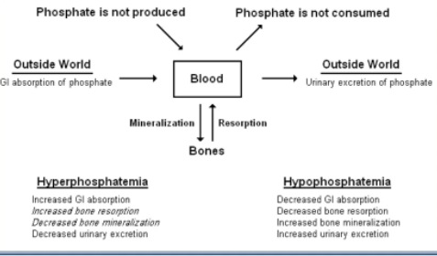

Slide 14
Diabetic Ketoacidosis:
Liver rapidly breaks fats to employ food source when glucose utilization by cells is effected by insulin. Occurs with various degree of intracellular phosphate depletion, partially because of shift of Phosphorus from extracellular to intracellular compartments. Basically it is a condition of Hypophosphatemia.

Slide 15
How phosphate causes Rickets and Oteomalacia:
Phosphate binds with Calcium for hardening and mineralization. When kidney cannot reabsorb phosphate effectively and to of this mineral in excreted from the body in urine.
As a result, not enough Phosphate is available in the blood stream to participate in normal bone growth and development. Rickets in children and Osteomalacia in adults occurs.

Slide 16
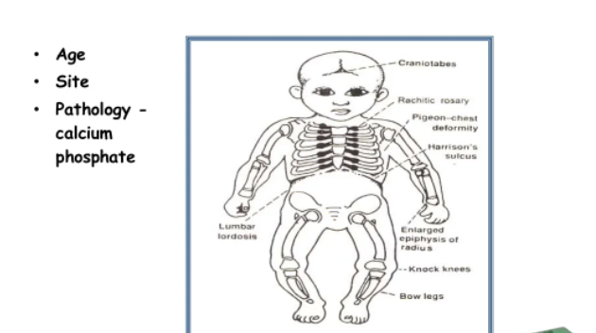

Slide 17
Thank you.
That’s all folks…………

